Slide 1

Basic Solutions Concepts (pt 3)
Chris Kiekintveld

Slide 2
Mixed Strategies
It would be bad to play any deterministic (pure) strategy in matching pennies
or Rock-Paper-Scissors, or a security game…
Randomness and unpredictability is a key element of strategic play, especially in adversarial games
Confuse opponents, or hide information
Randomization to mitigate risk
Randomization as an empirical description of play

Slide 3
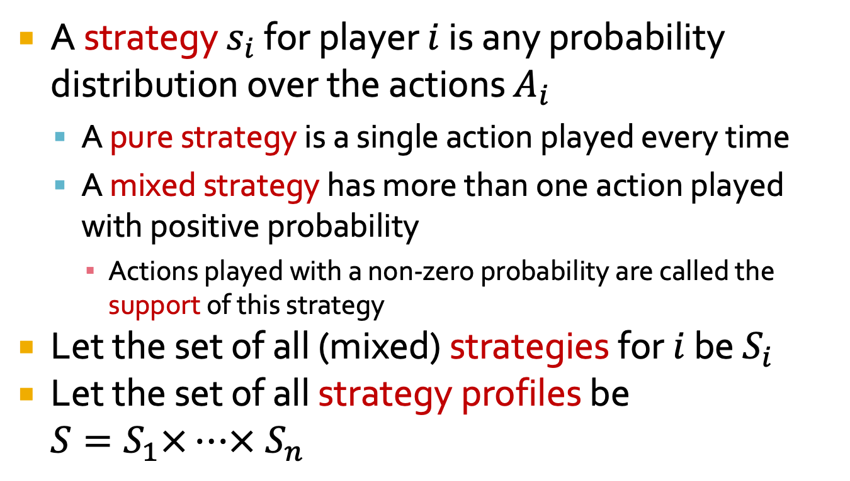
Mixed Strategy Definition
A strategy $s_{i}$ for player $i$ is any probability distribution over the actions $A_{i}$
A pure strategy is a single action played every time
A mixed strategy has more than one action played with positive probability
Actions played with a non-zero probability are called the support of this strategy
Let the set of all (mixed) strategies for $i$ be $S_{i}$
Let the set of all strategy profiles be $S=S_{1}×…×{ S}_{n}$

Slide 4
Utility with Mixed Strategies
What are the payoffs for the players when they play mixed strategies?
Cannot simply re
ad the number from the payoff matrix since we will end up in different outcomes with different probabilities
Payoffs are typically computed using expected utility (as in decision theory)

Slide 5
Mixed Strategy Nash Equilbrium
The definitions of best-response and Nash equilibrium generalize from pure strategies
A mixed-strategy profile is a Nash equilibrium iff every strategy is a best-response
Every actions with a positive probability must have the same expected value
All actions with zero probability must not be better than the actions with positive support
[Nash, 1950]: Every finite game has at least one mixed-strategy Nash equilibrium

Slide 6
Computing Mixed-Strategy Equilibria
In general, this is hard (PPAD-complete)
In special cases it is easier (zero-sum games, games with special structure)
One technique is to guess the support of the equilibrium and check for a solution
Useful for verifying equilibrium
Basis for support-search equilibrium

Slide 7
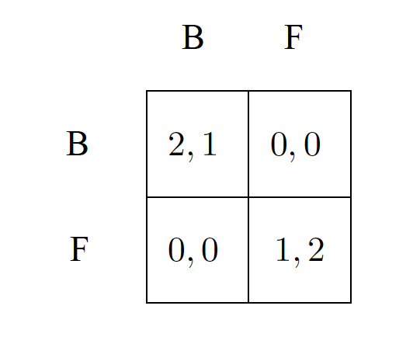
Example: BOS
Consider finding a mixed strategy equilibrium for the BOS game where every strategy is played with positive probability

Slide 8
Example: BOS
Let player 2 play B with probability p, F with probability 1-p
If player 1 best-responds with a mixed strategy, player 2 must make him indifferent between F and B (why?)

Slide 9
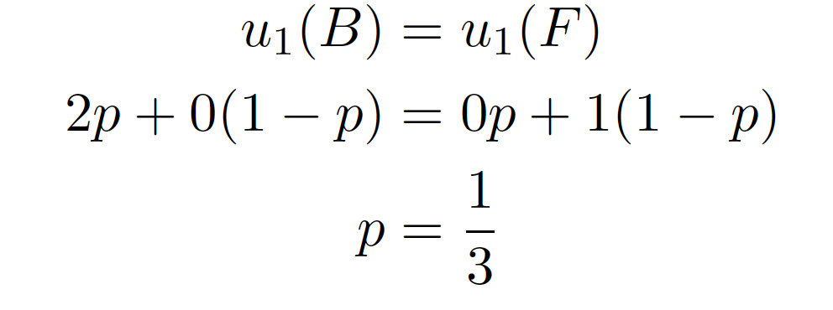
Example: BOS
Let player 2 play B with probability p, F with probability 1-p
If player 1 best-responds with a mixed strategy, player 2 must make him indifferent between F and B (why?)

Slide 10
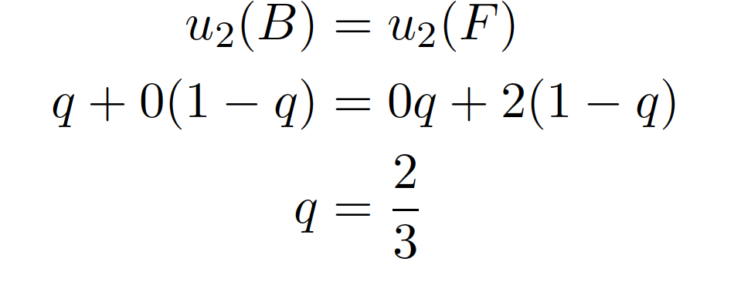
Example: BOS
Likewise, player 1 must make player 2 willing to randomize
Let player 1 play B with probability q, F with probability 1-q
So, the profile ((2/3,1/3), (1/3,2/3)) is a mixed-strategy NE

Slide 11
Interpreting Mixed Strategies
What does it mean to play a mixed strategy?
Confuse your opponent
Hide information
Uncertainty about opponent strategy
Risk mitigation
Description of play in repeated games
Description of population-level strategies

